Slide 1

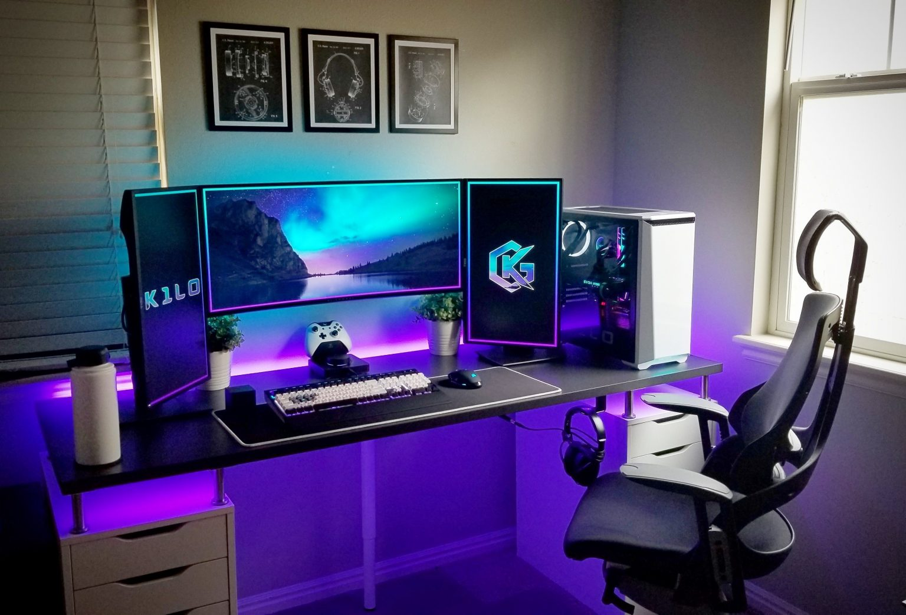
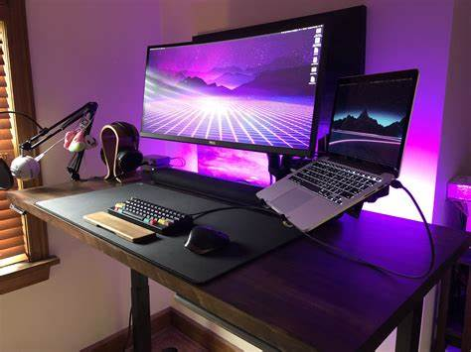
Welcom To Gamer Hub
A Patform where you can find whatever you search for in nich of gaming aNd gamE also IN CREATION CONTENT , content and where to buy from IF YOUR NEEDING A NEW SETUP OR START WITH NEW ONE .

Slide 2






WHAT’S OUR PLATFORM IS SERVING YOU ?
Our Platofrom is serving you best clients services with best support also where you can find whatever you want that have a relation with gaming Niche for example :
Setups .
Games .
Streaming Platform .
Also with a page where you can find all information about us and our social media and page where you can sign in and make your experiance even better

Slide 3
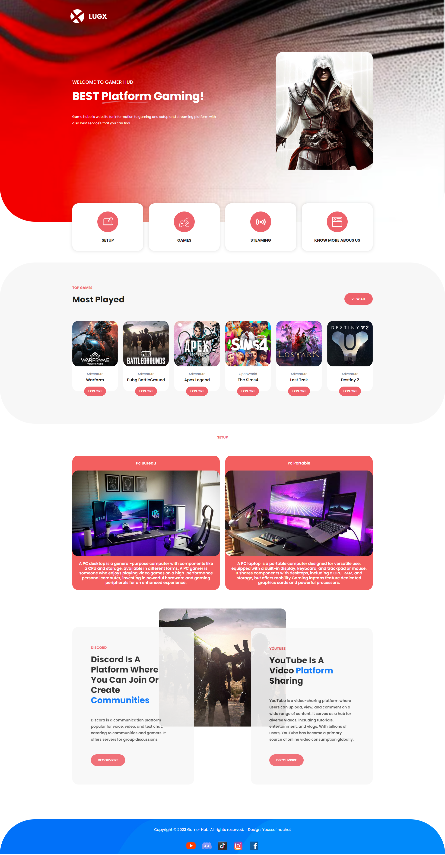
HOME PAGE
- Our home Page constitu with a big header with the logo of our store beside it there is link or what we can say other page that you can search more in it .
After our header we have some 3 section that ech one talk about a defferents utulisation in our platform start with :
Section of games where you can find most played games and a link where take u directy to games page then you can find every game you want and link that you for it
Section of setups it same for the games but there you can find desktop or laptop that you intress in it then when you click on the button learn more it take you to the best site that you can buy from it with high quality
- Section of streaming platform it has defferents so when you go inside the page you will find the most utulisable platform to watch content or creat content and most influencer and player with their name and photo and also how to start your account and profile on it ,

Slide 4


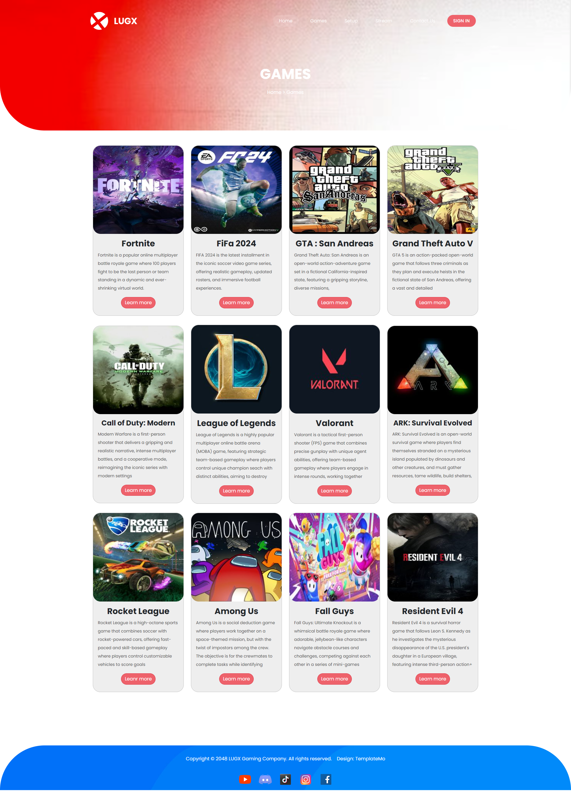


Game’s
- In this section like we have told befor you can find every game you like and most played one with their name and their description and a button learn more that take to the best application or website that you can download the game from it and have best experiance ever

Slide 5
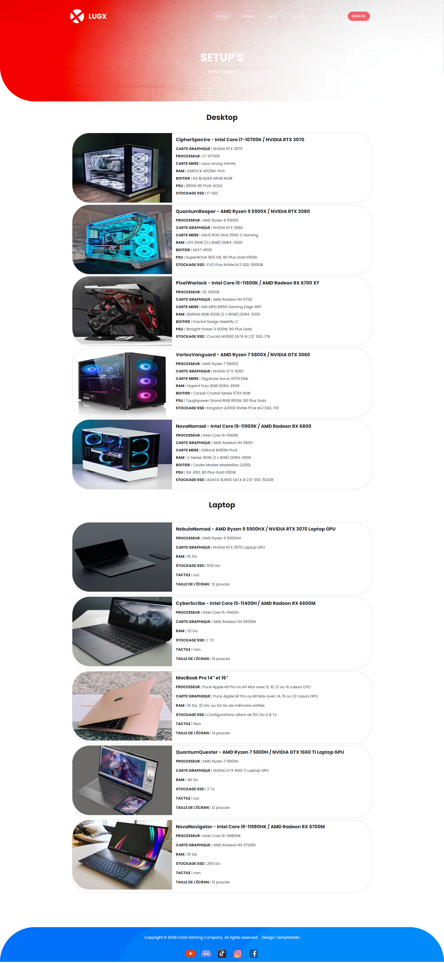
Setup’s
- The part Setup is the most helper i think in our platform because you can find most desktop or laptop are gaming with hight value inside them start from the processeur to the motherboard with a reasonable price that match anyone .

Slide 6
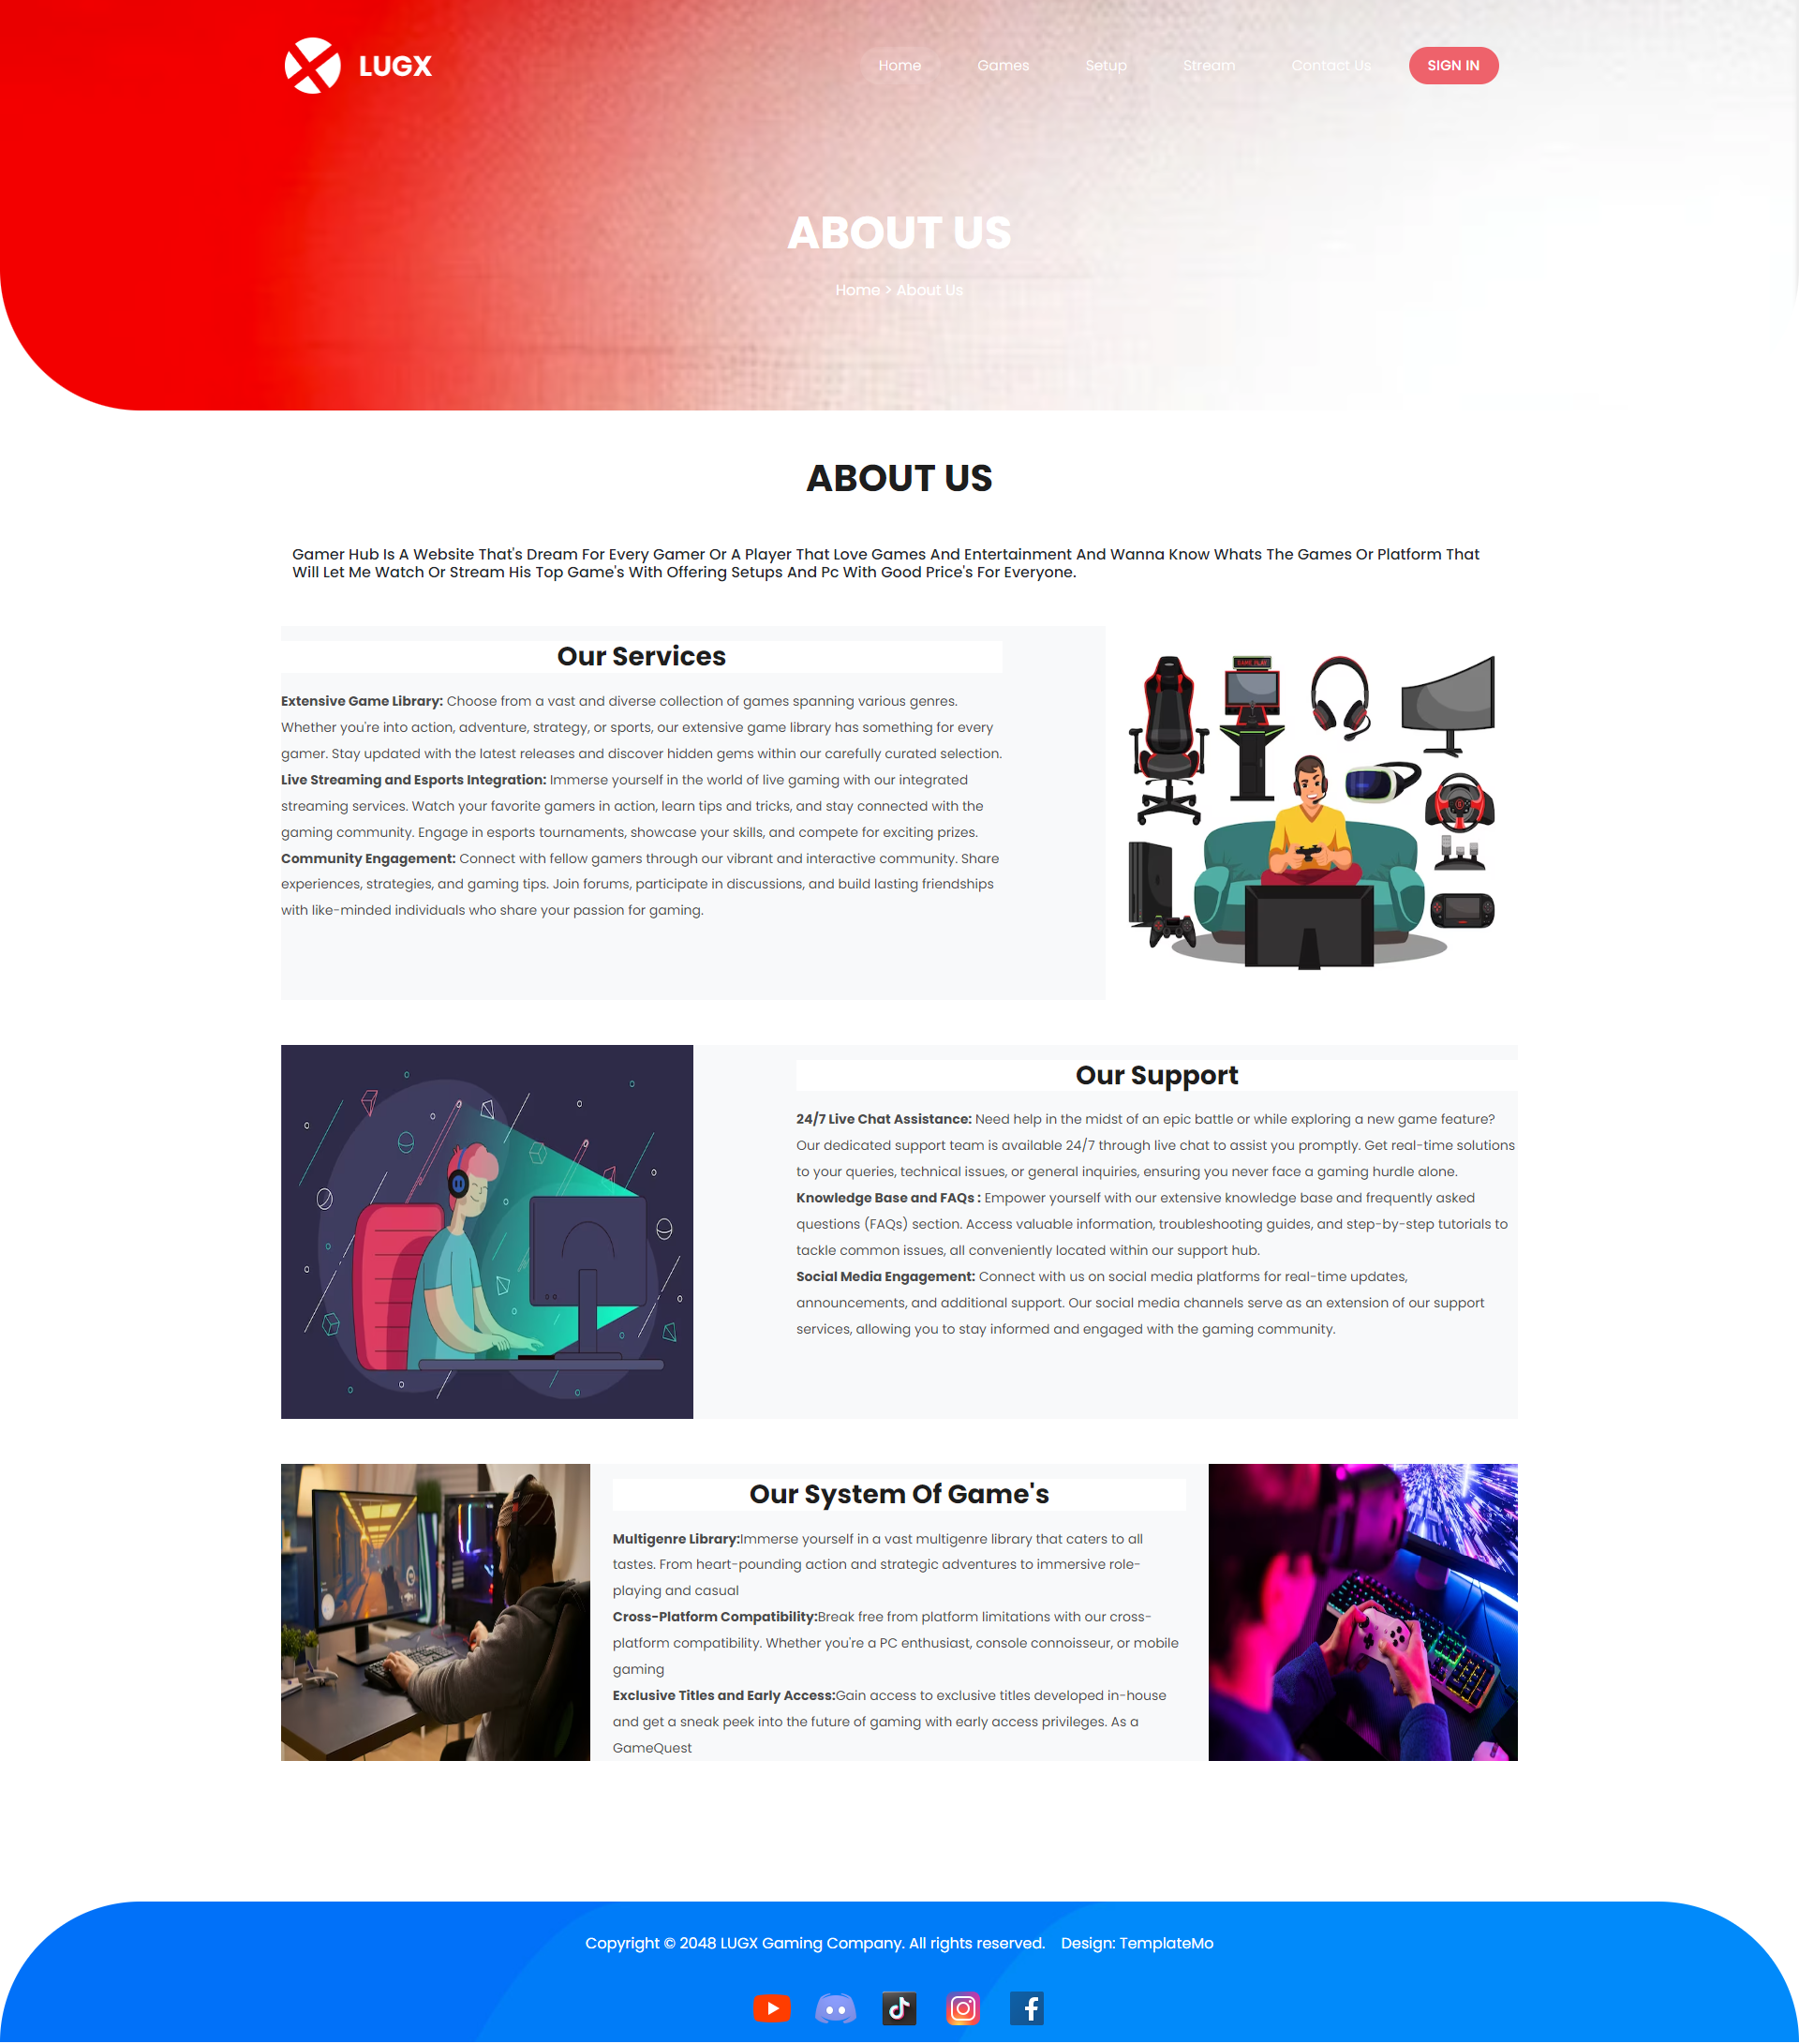
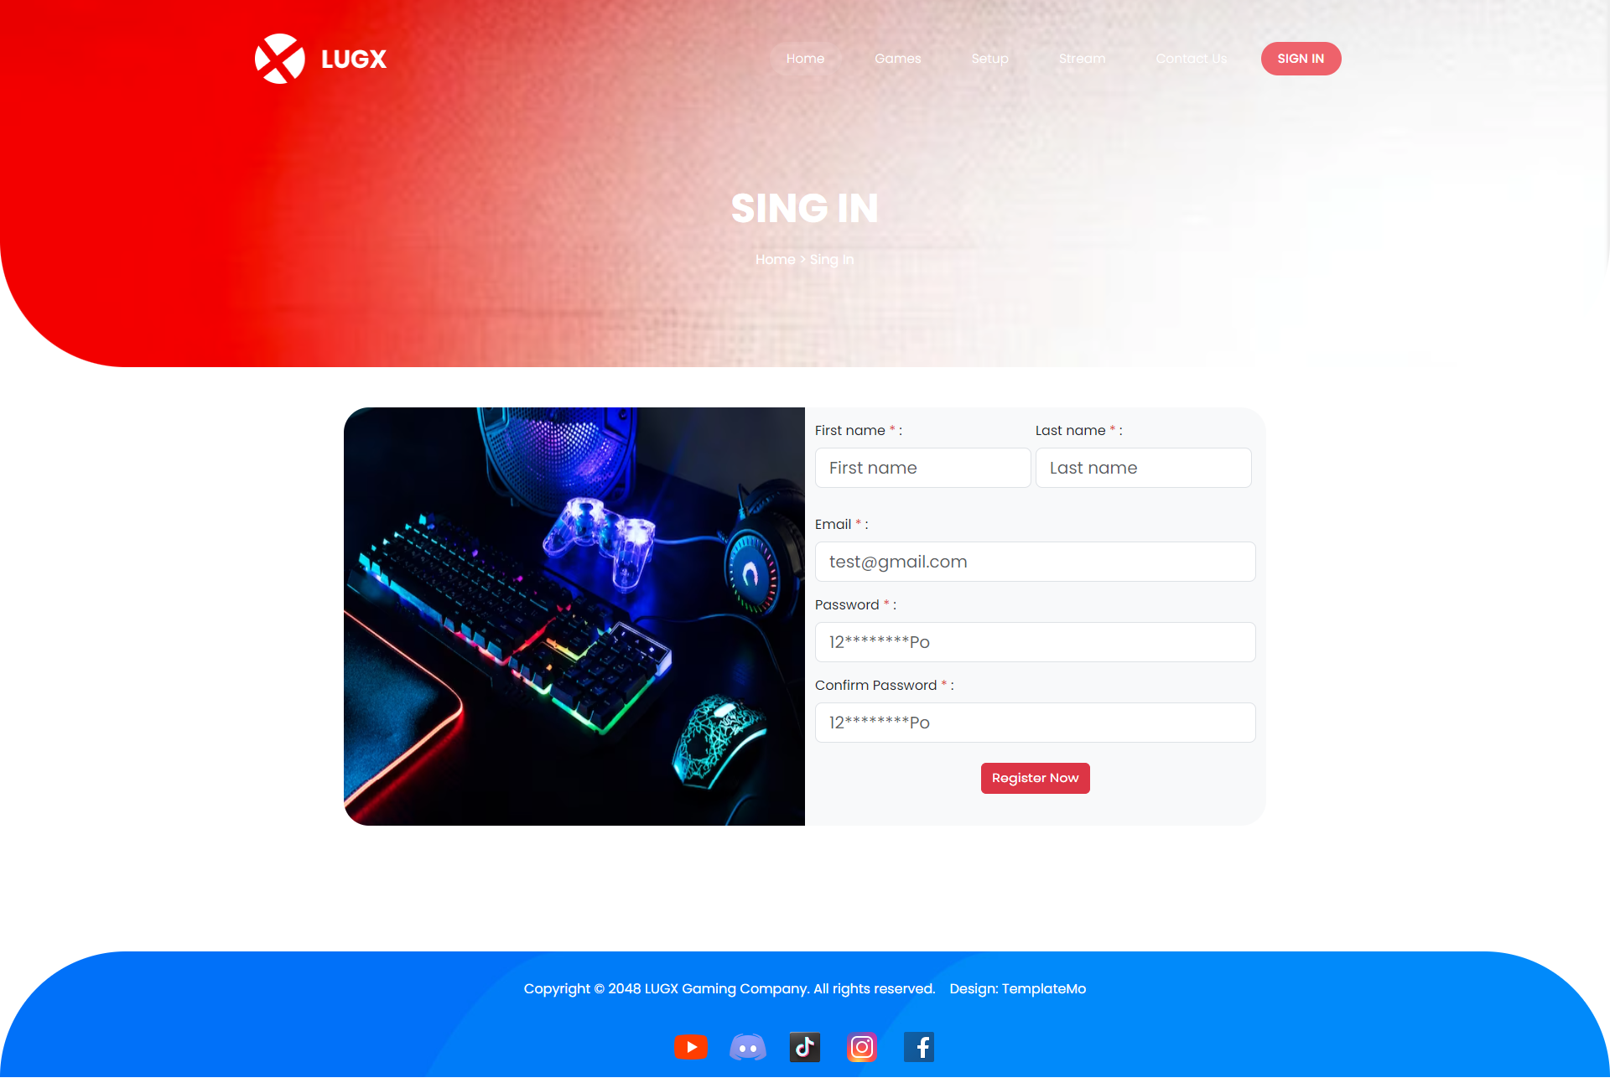
ABOUT US / SING IN
- These part of our platform i think its also from the important part of our platform because it give the user a better experiance from knowing us our services our support our system of game’s also making their experiance by sing in in out platform and give them our social media for they can contact us and they be free

